Slide 1
UI & UX Presentation

Slide 2
Team Members Name
1- Mennatallah Nabil Ali
2- Kareem Mohamed Snousi
3- Mahmoud Abdelaty Hamed
4- Mohab Khalid Mahmoud

Slide 3
Stakeholder Interview

Slide 4
Stakeholder Interview :
Where do you think the app should focus its service geo?
Who do you think the main competitores ?
Why would a user resort to using the app?
What features would you like to see in a food delivery app ?
Should be register in app to use it ?
It is necessary to access the geographic location or user enters it ?
What are payment methods ?
Do you want add google map in app ?

Slide 5
Stakeholder Interview :
Do you want filter the restaurants by governorate ?
What search methods are used by the user ?
Can user call delivery or chat or none ?
Does the user display the order status ?
As part of the order status ,users would like to view the location and arrival time , design a map experience for customers to view this information ?
Is there offers section on the app ?
What notifications would you like to appear to the user ?

Slide 6
Competitor Analysis

Slide 7
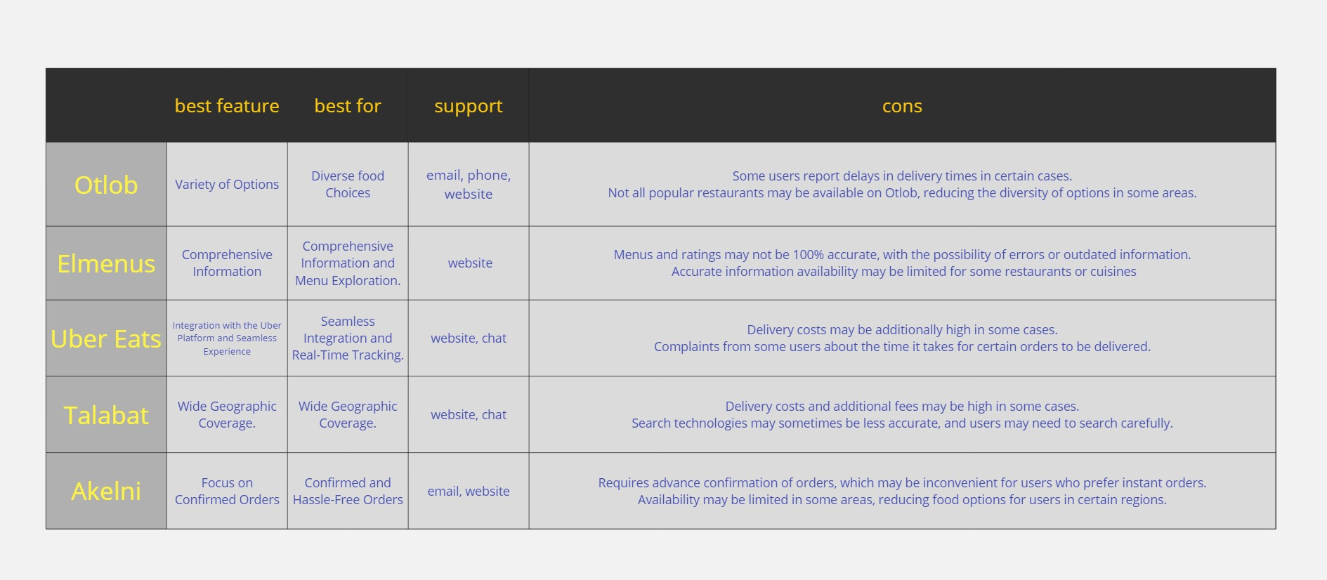
Competitor Analysis :

Slide 8
Survey

Slide 9
Survey :
1- How often do you use food app or website to order meals?
a. Daily
b. 2-3 times a week
c. Once a week
d. Rarely
2- What features do you find most important when using a food app or website?
a. User interface
b. Variety of restaurants
c. Delivery speed
d. Reviews and ratings
e. Customization options
f. Loyalty rewards
3- On a scale of 1 to 10, how satisfied are you with the current food apps or websites you use?
a. 1-3 (Very Dissatisfied)
b. 4-6 (Somewhat Dissatisfied)
c. 7-8 (Neutral)
d. 9-10 (Satisfied)

Slide 10
Survey :
4- What types of cuisine do you most frequently order through food apps or websites?
a. Italian
b. Asian
c. American
d. Mexican
5- Would you try a new food app or website if recommended by a friend?
a. Yes
b. No
6- What factors influence your decision to choose a particular restaurant on a food app or website?
a. Reviews and ratings
b. Menu options
c. Delivery speed
d. Discounts and promotions
e. Previous positive experiences
7- How would you rate the accuracy of estimated delivery times on the food app or website you use?
a. Very accurate
b. Somewhat accurate
c. Neutral
d. Inaccurate

Slide 11
Survey :
8- Which payment method do you prefer, cash or visa, when using a food app or website?
a. Cash
b. Visa/MasterCard
9- How satisfied are you with the customer service of a food app or website you've used before? And why?
a. Very satisfied
b. Somewhat satisfied
c. Neutral d. Somewhat dissatisfied
e. Very dissatisfied
10- Is the inclusion of nutritional information for menu items important to you when using a food app or website? And why?
a. Yes
b. No
11- How did you first learn about the food app you have used before?
a. App store recommendation
b. Social media advertisement
c. Friends or family
d. Online search

Slide 12
Survey :
12 - In terms of user experience, how would you rate the navigation and overall usability of the food app or website you currently use?
a. Excellent
b. Good
c. Fair
d. Poor
13- Would you recommend your favorite food app or website to others?
a. Yes
b. No
14- How important is it for a food app or website to provide a responsive and helpful customer support system?
a. Very important
b. Somewhat important
c. Neutral
d. Not important
15- In your opinion, how important is the accuracy of order tracking and real-time updates during the delivery process?
a. Very important
b. Somewhat important
c. Neutral
d. Not important

Slide 13
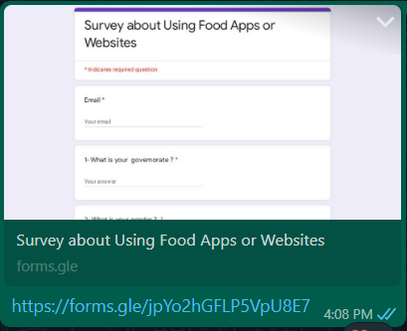
Survey :
16 - What is your governorate ?
……………………………………
17- What is your gender ?
a. Male
b. Female
18- What is your age range ?
a. under 18
b. 18 – 25
c. 25 – 45
d. 45 – 60
e. Greater than 60
https://docs.google.com/forms/d/e/1FAIpQLScHNYp5DXt8Fli1rkSDKH1_n5b6A4JowbL27A3n2-ZFEpbMsg/viewform

Slide 14
User Interview

Slide 15
User Interview :
Why do you choose one food delivery service over another ?
How often do you use food delivery apps ?
What features do you like or dislike in food delivery apps ?
What is your main reason for using a food delivery app ?
Have you faced any issues while using food delivery apps ? If yes, what were they ?
How do you discover various restaurants and food ?
How do you order food using these apps ?
How do you pay for your food orders ?
What additional features would you like to see in a food delivery app ?

Slide 16
Persona

Slide 17
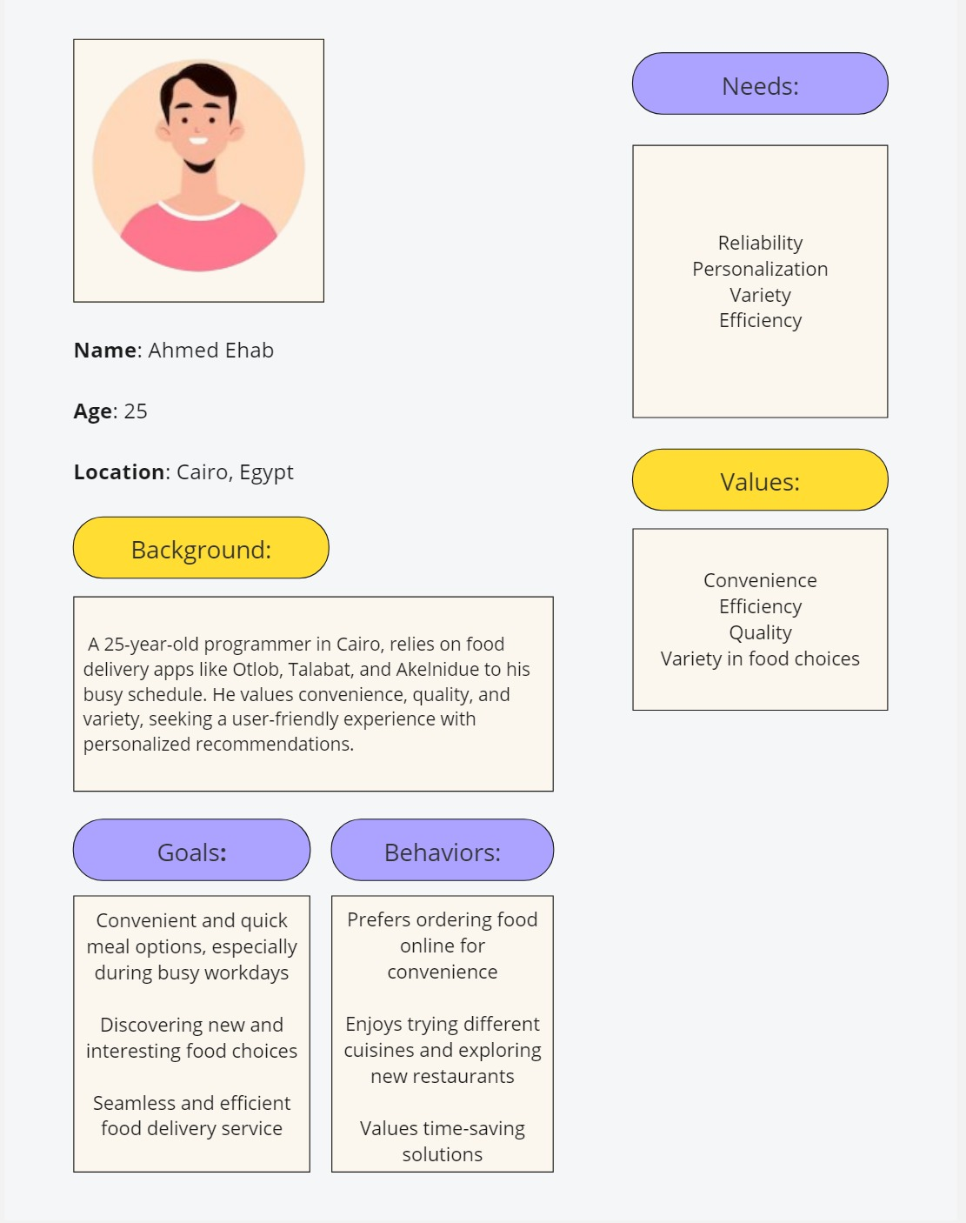
Persona:

Slide 18
Thank You

